Slide 1
Learning Path: Transform ideas into action with Copilot Chat
April 2025

Slide 2
Module 1: Get started with Microsoft 365 Copilot Chat

Slide 3
Introduction
Microsoft 365 Copilot Chat is your AI assistant for work, grounding Copilot conversations in both the latest large language models (LLM) and information from the web to help you get more done, spark your creativity, and deepen your knowledge.
In this module you’ll learn how to:
Describe the purpose of Microsoft 365 Copilot Chat and its key features.
Identify where and how to access Copilot Chat across Microsoft 365 applications.
Describe how web grounding delivers real-time, web-based answers and how it differs from work grounding.
Navigate the Copilot Chat interface and how to start chatting.
Describe how Enterprise Data Protection keeps your data secure while using Copilot Chat.
GCC High: Web grounding is NOT enabled by default. Admin must enable "Allow web search in Copilot" policy.
Notes:
Imagine you’re a business user looking for smarter, faster ways to manage your day, whether it's summarizing documents, brainstorming ideas, generating content or collaborating on team initiatives. You need a tool that empowers you to optimize your daily workflow and free up time for what matters most.
Microsoft 365 Copilot Chat is your AI assistant for work, grounding Copilot conversations in both the latest large language models (LLM) and information from the web to help you get more done, spark your creativity and deepen your knowledge.
In this module, you'll explore how Microsoft 365 Copilot Chat serves as a powerful AI assistant designed to streamline work and boost productivity. You'll gain an understanding of its core capabilities, including secure, enterprise-ready AI chat that combines web and work-based insights, and learn how to access Copilot Chat across various platforms like Teams, Outlook, Microsoft 365 apps, and Edge. You will also become familiar with the chat interface, discover how to navigate between Work and Web modes, and learn how to engage with Copilot.

Slide 4
What is Microsoft 365 Copilot Chat?
Microsoft 365 Copilot Chat is an enterprise-ready AI chat available at no extra cost to your Microsoft 365 subscription.
It grounds conversations in the latest large language models (LLMs) and information from the web to help you get more done, spark your creativity and deepen your knowledge.
Copilot Chat includes:
Secure, AI chat grounded in the web and powered by the latest GPT models.
A side-by-side experience that's aware of a user's open content in Word, Excel, PowerPoint, OneNote, and Outlook
Pay-as-you-go agents accessible from chat and priced on a metered basis
IT controls, including enterprise data protection and agent management
Features like Copilot Pages, file upload, and image generation
Copilot Chat’s features becomes even more powerful with a Microsoft 365 Copilot license in addition to your standard Microsoft 365 subscription.
Notes:
Microsoft 365 Copilot Chat is enterprise-ready AI chat available at no additional cost to your Microsoft 365 subscription. It’s your AI assistant for work, combining the power of the latest large language models (LLM) with web-based insights to help you with tasks like brainstorming, writing, coding, and searching. It provides intelligent suggestions and automates repetitive tasks to make your work easier.
TIP: "Grounding" is the data that the AI uses to do what you ask it to do.
NOTE: File upload and image generation limits apply. We may reduce the limit to keep Microsoft 365 Copilot Chat accessible to the widest number of people, such as during peak times. A SharePoint license is required to use Pages.
Get started with Microsoft 365 Copilot Chat - Microsoft Support
Whether researching industry insights, analyzing data, or looking for inspiration, Copilot Chat gives users access to better answers, greater efficiency, and new ways to get their work done through chat and agents.
GPT-5 in Copilot Chat: GPT-5 is the latest and most advanced AI model from OpenAI, integrated into Microsoft 365 Copilot Chat. It’s enterprise-ready, maintaining your organization’s security, compliance, and privacy settings. Copilot uses GPT-5’s high-throughput model for fast answers to routine questions, and switches to a deep reasoning model for complex prompts. Copilot also dynamically selects the best GPT-5 model for your needs, ensuring optimal results.
You can also choose to add a Copilot License to your Microsoft 365 subscription to ground Copilot in your Microsoft 365 data such as files, emails and Teams meetings. This course focuses on the features available with your Microsoft 365 subscription. The next slide shows a visual summary of the differences in feature availability.

Slide 5
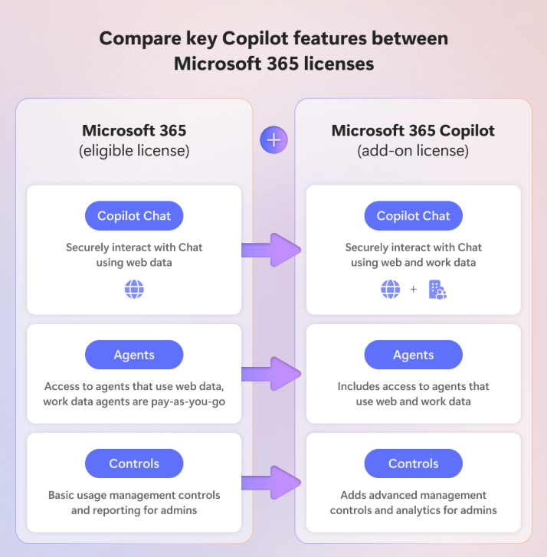
Differences between Microsoft 365 Copilot Chat and a Microsoft 365 Copilot add-on license
Video explaining the difference between Microsoft 365 Copilot Chat and Microsoft 365 Copilot
Notes:
Copilot Chat is AI chat grounded in data from the web and powered by the latest large language models (LLMs). Copilot Chat lets users access agents and create them in the Microsoft 365 Copilot app. Additionally, they can use features like Copilot Pages, file upload, and image generation.
Unlike Microsoft 365 Copilot, Copilot Chat is not grounded in organizational content like files, emails, or chats as part of the chat experience—it is grounded in data from the web only.
A paid license for Microsoft 365 Copilot includes Copilot Chat plus other Copilot value for users and admins. Microsoft 365 Copilot includes additional value like:
Chat grounded in work sources (files, meetings, emails, and chats) and priority access to capabilities like file upload and image generation, and reasoning capabilities and models (like GPT-5)
Integration in Microsoft 365 Copilot apps like Teams, Outlook, Word, Excel, PowerPoint, and more, with advanced skills and in-app editing
Comprehensive access to agents, including Analyst & Researcher advanced reasoning agents, prebuilt Microsoft agents, and custom agents grounded in your data
Additional Copilot Control System value like SharePoint Advanced Management and Copilot Analytics.

Slide 6
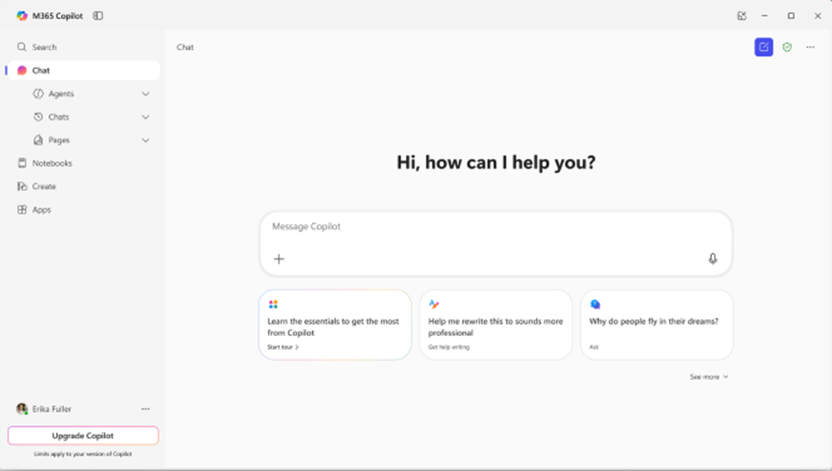
Microsoft 365 Copilot Chat interface
Agents Choose an agent from the list to chat with it, or expand the agent menu to find or create agents
Start a new chat button
Clear your past chat and start a new conversation.
Chat history View your past conversations
Prompt box
Start your conversation here
Copilot Chat Pages View your Pages that you’ve created
Dictation
Use dictation if you prefer to speak rather than type when you’re chatting with Copilot
Add content Expand to add reference files or images to your Copilot prompt
Suggested prompts Get started with prompt suggestions personalized to you.
Copilot Prompt Gallery Expand the suggested prompts to view the full Copilot Prompt Gallery, including saved prompts and prompts from your team
Notes:
Microsoft 365 Copilot Chat offers a UI designed to boost productivity and facilitate learning in both professional and educational settings. Users can easily identify their protection status by the green shield icon located in the top right corner of the interface. The right panel provides quick access to agents and recent chats, while the center of the UI offers suggested prompts to help users get started efficiently.
The screen above shows the interface with a license. If you have a Microsoft 365 Copilot license, you’ll see a toggle at the top of the screen for work mode and web mode. Without a license, this toggle will not appear. Note that Agent creation is only available if your organization’s Admin has enabled this capability.

Slide 7





How to chat in 3 steps
1. Enter your prompt
2. Check sources
3. Continue the conversation
Enter your detailed prompt in the text box. If you would like Copilot to source information from any reference files, you can upload them in your prompt by selecting the “Add content” button.
Copilot Chat is transparent about the sources of its information. See these sources listed underneath the answer.
Vet these sources and validate your answers.
You can ask follow-up questions as you would in a conversation. You can refine the answer too.
For example, try “Write a shorter answer" or "Give me more detail." You can also select suggested prompts.
GCC High: Web grounding is NOT enabled by default. Admin must enable "Allow web search in Copilot" policy.
Notes:
To chat using Copilot Chat, start by entering a clear and specific prompt to get accurate responses.
What is a “prompt?” Prompts are how you have a conversation with Copilot Chat. Use natural, plain, and clear language to ask Copilot questions or give instructions, while providing context as you would with an assistant. We’ll dive deeper into the art of prompting and how to structure a prompt to get the best outcome in Module 2.
Next, verify the sources of the information provided to ensure reliability, especially for critical tasks.
Finally, continue the conversation by asking follow-up questions to refine the responses and obtain more detailed information. Think of Copilot Chat as a collaborative tool that supports you throughout your tasks by providing ongoing assistance and information.

Slide 8
Data security in Copilot Chat
While using AI, keeping enterprise data safe is essential. Microsoft ensures this through Enterprise Data Protection (EDP), a set of security and privacy controls designed to safeguard your data.
How Microsoft 365 Copilot Chat Keeps Your Data Safe
Encryption & data isolation
Protects data at rest and in transit.
Privacy by design
Your data remains private. It is not used to train AI models.
Access controls
Regional compliance
Copilot respects your organization’s permissions, sensitivity labels, and retention policies.
Data stays within your geographical region, following Microsoft’s processing commitments.
Notes:
What is Enterprise Data Protection (EDP)?
Enterprise Data Protection (EDP) ensures that your organization's data is secure, private, and compliant when using Microsoft 365 services, including Microsoft 365 Copilot Chat. These protections are governed by Microsoft's Data Protection Addendum (DPA) and Product Terms, which outline the commitments to safeguard customer data.
Microsoft 365 Copilot Chat keeps your data secure with built-in safeguards that align with your organization's security policies. It inherits your existing Microsoft 365 security and compliance settings, ensuring only authorized users can access generated content.

Slide 9

Knowledge check
Test your knowledge with this real time quiz.
Prompt Microsoft Copilot Chat:
As a Microsoft Copilot Chat expert, please create three multiple-choice questions that assess knowledge of key features, including how to access Copilot Chat, its different modes, how to initiate it, and the concept of EDP. Present one question at a time and wait for my response before continuing. After each answer, provide a brief explanation of the correct choice before moving on to the next question.
Notes:
Prompt Microsoft Copilot Chat:
As a Microsoft Copilot Chat expert, please create three multiple-choice questions that assess knowledge of key features, including how to access Copilot Chat, its different modes, how to initiate it, and the concept of EDP. Present one question at a time and wait for my response before continuing. After each answer, provide a brief explanation of the correct choice before moving on to the next question.

Slide 10

Summary
What you learned
Now you’re ready to get started with Microsoft 365 Copilot Chat.
Now that you’ve completed this module, you’re able to:
Describe the purpose and key features of Microsoft 365 Copilot Chat.
Identify where and how to access Copilot Chat across Microsoft 365 applications.
Describe how web grounding delivers real-time, web-based answers and how it differs from work grounding.
Navigate the Copilot Chat interface and how to start chatting.
Describe how Enterprise Data Protection keeps your data secure while using Copilot Chat.
▶ HANDS-ON: Exercise 1 — Getting Started with Copilot Chat (30 min) | exercises/Exercise-1-Getting-Started.md
Notes:
In this module, you explored how Microsoft 365 Copilot Chat functions as a secure, AI-powered assistant designed to enhance workplace productivity. You gained insight into its core functionalities and features, including enterprise-ready chat grounded in both web data and work data. You learned where and how to access Copilot Chat across Microsoft 365 platforms such as Microsoft 365 apps, Edge, and the Microsoft 365 app. You also became familiar with the user interface and discovered how to engage with Copilot through natural language all within a protected and intuitive environment.

Slide 11
Module 2: Write effective prompts to achieve optimal results

Slide 12
Introduction
This module covers the topic of effectively communicating with Microsoft 365 Copilot Chat. It delves into the art of writing effective prompts by exploring key elements, best practices, and the Prompt Gallery to help you achieve optimal results.
In this module you’ll learn how to:
Identify the four key elements of an effective Copilot prompt: context, goal, source, and expectations.
Apply best practices to write clear, concise, and well-structured prompts.
Recognize common prompting mistakes and how to avoid them.
Utilize the Microsoft Copilot Prompt Gallery to discover, save, edit, and share useful prompts.
Notes:
Imagine you're a business user at a tech company that uses Copilot Chat to help with various tasks such as researching competitors, drafting new content, or analyzing data. However, sometimes you don’t know how to frame your request to Copilot to get the desired result. This module will help you navigate these challenges and make the most out of your interactions with Copilot.
In this module, you’ll delve into the art of writing effective prompts for Microsoft 365 Copilot Chat, ensuring you can communicate your needs clearly and concisely to achieve optimal results. You’ll explore the essential elements of crafting well-structured prompts, including the importance of context, goals, sources, and expectations. Additionally, you’ll review best practices and common pitfalls to avoid when prompting, ensuring high-quality, relevant responses from Copilot. Lastly, the module introduces the Microsoft Copilot Prompt Gallery, a valuable resource for discovering, saving, and sharing prompts to enhance daily workflows and inspire productivity across different roles and tasks.

Slide 13
Write an effective prompt (1/2)
Include the right prompt ingredients
To get the best response, it’s important to focus on some of the key elements when phrasing your Copilot prompts.
Context
Goal
Source
Expectations
Why do you need it and who is involved?
What do you want Copilot to do?
Where should Copilot look for information?
How should Copilot deliver the answer?
Notes:
Prompts are your way of communicating with Microsoft 365 Copilot Chat, asking it to perform tasks such as creating, summarizing, editing, or transforming content. Think of prompting as having a conversation with an assistant, using clear and straightforward language while providing the necessary context.
The following steps highlight the most important things to consider when building an effective prompt.
Provide context: Why do you need it and who is involved? Provide context and details about your goal, such as preparing for a client meeting or trying to write an all-hands speech. Specify the focus, like a particular client or topic. Unlike traditional search, Copilot responds best to detailed prompts.
Describe a goal: What do you want Copilot to do? Specify the desired output for Copilot, whether bullet points, an essay, an email, or a brainstorming draft. Generative AI excels at imitation, so provide examples to guide its response.
Define a source: Where should Copilot look for information? If you specify the information Copilot should use, you’ll get better results. Upload specific files or detail the types of web sources that Copilot should focus on.
Set expectations: How should Copilot deliver the answer? State your expectations for how Copilot should deliver its response. What audience is it aimed at? What kind of tone are you thinking for this assignment? Usually, that involves some explanation about who you are and what you’re trying to achieve.

Slide 14
Write an effective prompt (2/2)
Context
Goal
To get the best response, it’s important to focus on some of the key elements when phrasing your Copilot prompts.
Why do you need it and who is involved?
What do you want Copilot to do?
I work in marketing and focus on competitor research. Give me a concise summary of recent news about [company name]. Focus on web articles from the last 2 months. Provide the answer in two to three paragraphs and use a business tone.
Source
Expectations
Where should Copilot look for information?
How should Copilot deliver the answer?
Notes:
Prompt and iterate
To maximize the value of Copilot Chat, crafting well-thought-out prompts is essential. Clear, concise, and specific instructions significantly improve the quality of results. However, the true power of Copilot often emerges through iteration and conversation. Instead of settling for the first response, refine and experiment with follow-up prompts to achieve the desired outcome. For example, if the initial result focuses on the wrong time period or provides a block of text when a numbered list is preferred, simply adjust your instructions. Copilot thrives in a back-and-forth conversational experience, enabling you to uncover its full potential through collaboration and refinement.
Tip: Once Copilot generates a response to your prompt, select the sources to understand how the response was cited. AI-generated content may be incorrect, so sources are provided for your review when possible.

Slide 15
Prompting best practices
Be clear and specific
Keep it conversational
Give examples
Ask for feedback
Write legibly
Check for accuracy
Provide details
Be polite
Iterate and refine
Be vague
Request inappropriate or unethical content
Use slang, jargon, or informal language
Give conflicting instructions
Interrupt or change topics abruptly
Notes:
Do's
Be clear and specific. Provide specific instructions to Copilot, such as topic, purpose, tone, and required length. For example, if you want to track industry news, you might say, "Give me a concise summary of recent news about [Product X]."
Keep it conversational. Frame your prompts as if you are having a conversation and give feedback to Copilot based on the quality of its responses to help the AI learn and match your preferences.
Give examples. Use clear and specific keywords or phrases when asking Copilot to write a piece of text for you. This helps it generate more relevant and creative copy.
Ask for feedback. Requesting feedback from Copilot helps it to understand your needs and preferences, and to provide you with more relevant, helpful responses.
Write legibly. Use correct punctuation, capitalization, and grammar when writing prompts, as this will help the AI produce better quality text and responses.
Check for accuracy. Occasionally, Copilot may make mistakes. Always check Copilot’s responses for accuracy, grammar, and style, and watch out for irrelevant or inappropriate content.
Provide details. Provide Copilot with contextual details to help it generate more accurate, consistent responses. For example, the genre, characters, and plot to a story.
Be polite. Using kind and respectful language when chatting with Copilot helps foster collaboration and improves the AI's responsiveness and performance.
Iterate and Refine: If the initial output isn't perfect, refine your prompt and try again. Prompting is an iterative process, and practice makes perfect.
Don'ts
Be vague. When prompting Copilot, avoid using vague language, and be as clear as possible to receive better-quality responses.
Request inappropriate or unethical content. Copilot is not responsible for the content or the consequences of your writing. You should respect local laws, rules, and the rights of others.
Use slang, jargon, or informal language. This may cause Copilot to give low-quality, inappropriate or unprofessional responses.
Give conflicting instructions. Prompting Copilot to perform a task that includes multiple or conflicting pieces of information in the same request can confuse the AI and result in lower quality responses.
Interrupt or change topics abruptly. This could disrupt Copilot’s writing process. Always close or finish a task before starting a new one. When starting a new task, write “New task.”

Slide 16
Examples of web-based Prompts
Revise content
Can you help me rewrite this paragraph to make it clearer and more concise?
Generate ideas
List ideas for a fun remote team building event.
Start your research
How have world literacy rates changed in the past 30 years?
Code faster
Write a Python script to perform binary search.
Draw conclusions
Help me analyze the data from my experience using this /file.
Notes:
These prompts provide a good starting point. Reiterating these prompts and adding more context and detail will return more specific and relevant results for you.
Ask your learners to brainstorm ways to improve these prompts using the components of an effective prompt discussed in the previous slides.

Slide 17
AI Hallucinations: What They Are and Why They Matter
What is an AI hallucination?
A response where Copilot presents fabricated information as fact — invented statistics,
nonexistent agreements, fictional events, or made-up citations that sound authoritative.
Why does this happen?
- Large language models predict the most plausible next words, not verified facts
- Copilot does not "know" things — it generates text that matches patterns in its training
- The more specific or obscure your question, the higher the hallucination risk
Why it matters in a DOJ environment
- A fabricated case citation in a legal brief or filing can have direct legal consequences
- An invented statute or regulation could undermine an enforcement position or court filing
- Incorrect program data could mislead congressional reporting or leadership decisions
Bottom line: Copilot is a powerful first-draft tool, not an authoritative source.
Always verify before you trust.

Slide 18
Detecting and Preventing Hallucinations
How to detect hallucinations
- Always check the source links beneath Copilot's response
- Challenge Copilot: "How confident are you? Can you confirm with a direct source?"
- Watch for red flags: very specific numbers without sources, obscure details presented with high confidence
- Cross-reference critical facts with authoritative sources (DOJ publications, justice.gov, official press releases)
1. Constrain to known sources
- "Based only on U.S. Department of Justice press releases and justice.gov publications..."
- "If information is not publicly available, say so rather than speculating."
2. Demand inline source attribution
- "For each claim, include the source name and date in parentheses."
- "Do not include any information you cannot attribute to a specific source."
3. Upload authoritative documents
- Upload the source file and prompt: "Using only the attached document, summarize..."
- This grounds Copilot in verified content rather than web search
4. Request a confidence level
- "If you are unsure about any detail, flag it as unverified."
- "Rate your confidence in each claim as High, Medium, or Low."

Slide 19
The Verification Rule for DOJ Professionals
Before any Copilot output goes into an official product, apply this checklist:
**☑ Check sources** — Click every source link. Does it actually say what Copilot claims?
**☑ Verify specifics** — Numbers, dates, names, and quoted statements are the most
common hallucination targets. Cross-reference with authoritative sources.
**☑ Challenge confident claims** — If Copilot sounds very sure about something obscure,
that is a red flag, not a green light.
**☑ Use document grounding for accuracy-critical tasks** — Upload the source
document and constrain Copilot to it.
**☑ Treat output as a first draft** — Copilot is a skilled but new analyst on your
staff. Good output, but always needs a senior review.
You will practice all of these techniques in Exercise 2, Task 2.2.

Slide 20
Examples of work-based prompts
Check your schedule
When is my next one-on-one with /person?
Decode acronyms
What does [company acronym] stand for?
Stay on top of email
What should be on my radar from emails last week?
Catch up on a meeting
Recap /meeting
GCC High: Work-grounded prompts (meetings, emails, chats) require a Microsoft 365 Copilot license and are limited in GCC High.
Notes:
With a Microsoft 365 Copilot license, you can prompt Copilot regarding your work-related data.
These prompts provide a good starting point. Reiterating these prompts and adding more context and detail will return more specific and relevant results for you.
Ask your learners to brainstorm ways to improve these prompts using the components of an effective prompt discussed in the previous slides.

Slide 21
Get inspired with Copilot Prompt Gallery
Prompt Repository
Edit prompts
Save, reuse, and share
Curated prompts
Enhance productivity
Notes:
What is the Microsoft Copilot Prompt Gallery? Previously known as Copilot Lab, the prompt gallery is your go-to resource for finding prompting inspiration to make the most of Copilot in your daily workflow. The prompt gallery includes a range of prompts curated by Microsoft to cover common scenarios and tasks. These prompts are designed to be versatile and applicable across different roles or industries, making them a valuable resource for all Copilot users.
Curated Prompts: It offers a large selection of pre-vetted prompts that users can use in Copilot Chat and across Microsoft 365 apps.
Edit existing prompts: Select an existing prompt and customize it to better suit your specific needs or create your own prompt. While the curated prompts are a great starting point, editing existing prompts allows you to tailor the content to your unique context and preferences.
Save, reuse, and share: If you find a prompt particularly useful, whether it’s an existing prompt, one that you customized or one you created from scratch, you can bookmark it for future reference. It then appears in the “Your Prompts” tab for easy retrieval. If you want to share a prompt with colleagues, you can do that right from the Prompt Gallery by clicking the “Share prompt” icon or hover over a sent prompt and select the same icon. Once shared, everyone in that team will see the prompt under the “Team prompts” tab
Enhanced Productivity: The gallery helps users understand how to interact with Copilot to maximize its functionality and efficiency, providing tips and tricks to improve prompting skills.

Slide 22
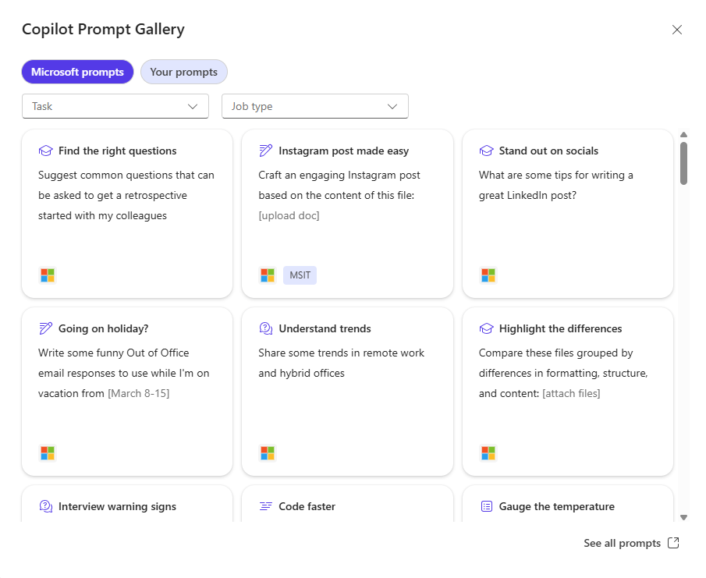
How do I use the Prompt Gallery to discover and share Copilot prompts?
Access the Prompt Gallery in Copilot Chat by selecting See more under the initial prompt suggestions and selecting the Prompt Gallery button at the bottom of the list. Here, you’ll see more Copilot prompts and your saved prompts.
Copilot Prompt Gallery helps you find prompting inspiration so you can take greater advantage of Copilot in your daily work.
Notes:
Access existing prompts and saved prompts from the Prompt Gallery in Microsoft 365 Copilot Chat and through Microsoft 365 applications when you have a Microsoft 365 Copilot license. Select “View prompts” next to the Copilot prompt box and a window will display where you'll see suggested Copilot prompts and your saved prompts. Select “See all prompts” at the bottom right of the window to access the full Prompt Gallery experience.

Slide 23
Knowledge check
Test your knowledge with this real time quiz.
Prompt Microsoft Copilot Chat:
As a Microsoft Copilot Chat expert, please create three multiple-choice questions focused on the elements of well-crafted prompts, common mistakes to avoid, and the purpose of the Microsoft Copilot Prompt Gallery. Present one question at a time and wait for my response before continuing. After each answer, provide a brief explanation of the correct choice before moving on to the next question.
Notes:
Prompt Microsoft Copilot Chat:
As a Microsoft Copilot Chat expert, please create three multiple-choice questions focused on the elements of well-crafted prompts, common mistakes to avoid, and the purpose of the Microsoft Copilot Prompt Gallery. Present one question at a time and wait for my response before continuing. After each answer, provide a brief explanation of the correct choice before moving on to the next question.

Slide 24
Summary
What you learned
You’re now able to write effective prompts and navigate to and use the Copilot Prompt Gallery.
Now that you’ve completed this module, you’re able to:
Identify the four key elements of an effective Copilot prompt: context, goal, source, and expectations.
Apply best practices to write clear, concise, and well-structured prompts.
Recognize common prompting mistakes and how to avoid them.
Utilize the Microsoft Copilot Prompt Gallery to discover, save, edit, and share useful prompts.
▶ HANDS-ON: Exercise 2 — Effective Prompts + Hallucination Detection (75 min) | exercises/Exercise-2-Effective-Prompts.md
Notes:
In this module, you gained practical skills for communicating effectively with Microsoft 365 Copilot Chat by learning how to write prompts that deliver clear, actionable results. You explored the four key elements of an effective prompt: context, goal, source, and expectation, and how providing this information helps Copilot generate more accurate and relevant responses. You also learned the importance of prompt iteration, refining your input through follow-up questions and feedback to improve outcomes. Additionally, you reviewed a set of best practice, such as using plain language, staying specific, and avoiding vague or conflicting instruction, while also identifying common pitfalls that can lead to poor results. Lastly, you were introduced to the Copilot Prompt Gallery, a powerful tool for finding, customizing, saving, and sharing prompts that can enhance your workflow and support productivity across a variety of business tasks.

Slide 25
Module 3: Work smarter with Copilot Chat

Slide 26
Introduction
This module discusses how you can use Microsoft 365 Copilot Chat to enhance your productivity within a secure, enterprise-ready environment and through Microsoft 365 apps. It also discusses how Copilot Chat eases collaboration via Copilot Pages and automates your workflow with Copilot Agents.
By the end of this module, you’ll be able to:
Leverage Copilot Chat to brainstorm ideas, summarize information, create content, visualize data, and generate code.
Upload and analyze files to generate insights and create new content.
Use Copilot Pages to collaborate in real-time and organize content in a shared workspace.
Describe how Copilot Agents automate and personalize tasks.
Leverage Copilot Chat across Microsoft 365 apps to streamline your workflow.
Notes:
Microsoft 365 Copilot Chat is your go-to AI chat for getting work done. It's powered by broad knowledge from the web and designed to be safe and secure for business use. It represents a foundational shift in how we work, enabling everyone to work smarter, faster, and more collaboratively. Whether you need to brainstorm, create, or check something off your to-do list, Copilot Chat is here to help you achieve your goals efficiently and effectively.
In this module, you explore how to work more intelligently and collaboratively with Microsoft 365 Copilot Chat by leveraging its enterprise-grade AI capabilities. You'll discover how to work smarter through features like summarizing content, generating ideas, analyze files, visualizing data, and write code, all through natural, conversational prompts. You’ll learn how you can use Copilot Chat right in the Microsoft 365 apps you use daily, making it a seamless part of your workflow. You'll also learn how to cocreate in real-time using Copilot Pages, transforming AI-generated responses into collaborative workspaces. Additionally, you explore Copilot Agents, which help automate tasks and streamline workflows. Lastly, you’ll have the opportunity to complete hands-on exercises designed to reinforce and apply what you’ve learned in the other units.

Slide 27
How can I use Copilot Chat?
Get summaries and stay informed
Brainstorm and draft content quickly
Gather insights based on your files
Visualize your data
Generate code and formulas
Summarize large amounts of data, gather and analyze market trends, competitor strategies, product development or customer insights.
Generate and refine ideas for presentations, reports, or proposals. Draft, rewrite, or polish content in different styles and formats.
Upload or reference any file to the chat and ask Copilot to provide insights, summarize key points, or generate new content based on the file.
Transform your data and ideas into a unique, AI-generated image, chart or infographic.
Save time, reduce errors, and adapt code or formulas to your specific needs and tools.
Notes:
Microsoft 365 Copilot Chat is a multifunctional AI assistant designed to optimize workflows, boost productivity, and aid in decision-making for various tasks. It excels in:
Summarizing essential information: Quickly get the gist of projects, people, and meetings.
Generating content: Draft, rewrite, or refine content with ease.
Analyzing documents: Gain insights from your documents. NOTE: You can reference documents directly by typing “/” in the prompt box to add individual files from your organization.
Visualizing data: Transform data into compelling visuals.
Coding: Generate and analyze code.
Whether you need market research, content ideation, data evaluation, or AI-generated visuals, Copilot Chat simplifies complex tasks through user-friendly prompts. Discover its features to enhance your knowledge, create effectively, and harness AI for smarter work solutions.

Slide 28
Try these prompts (1/2)
Summarize and stay informed
Summarize recent statements made by the CEO of [company name]
Prepare a daily brief of news from the [finance] industry regarding [cryptocurrency]
How do you say [thank you for your time] in [Japanese]?
Give me step-by-step instructions for [making an Instagram reel]
Brainstorm and draft content
Rewrite this to sound more professional and less verbose: [insert content]
Suggest inexpensive ways to optimize our website for organic search
Draft a blog post about the latest on [specific topic]
Help me create questions for a user research survey on [specific topic]
Gather insights from files
Help me rewrite the introduction paragraph to make it clearer and more concise in this document: /file
Suggest 10 compelling titles for this blog post: /file
Describe the image in a couple sentences: /file
Help me analyze the data from my experiment using this: /file
Notes:
Summarize and stay informed: Copilot Chat effectively summarizes extensive data into clear insights, enabling users to stay informed. It can analyze market trends, competitor strategies, product updates, and customer insights, making it a useful resource for business research. Additionally, Copilot offers access to current research papers, articles, and tutorials to encourage ongoing learning.
Brainstorm and draft content: Copilot Chat assists in generating ideas, drafting, rewriting, or enhancing content, whether it's a storyboard, blog post, newsletter, or executive summary. Following your guidance and web insights, it transforms basic concepts into refined content.
Gather insights from files: Copilot Chat can evaluate files you upload in the chat. You can upload Word documents, PowerPoint presentations, Excel spreadsheets, images, and PDFs to ask Copilot questions, gain insights, summarize essential points, or create new content. To upload, click the "(+) Add content" button or drag and drop a file into the chat.
NOTE: There are limits on file uploads, and files are stored in OneDrive for Business. Users can delete their uploaded files anytime, and they are not used for model training.

Slide 29
Try these prompts (2/2)
Visualize data
Illustrate a [romantic pop art image] of [an office worker experiencing a dramatic coffee crisis]
Create a line chart showing the relationship between [inflation rates] and [interest rates] over the last 20 years
Create a word cloud based on the latest [financial news]
Generate code
Tell me what this code does: [insert code]
Help me find errors in this code: [insert code]
Write a Python script to perform binary search
Convert this code to TypeScript
Write a SQL query to return all columns from the table where [the sales are above 10000]
With a Microsoft 365 Copilot License
Summarize Teams messages where I was @mentioned this week
What’s the latest from /person, organized by emails, chats, and files?
Help me find the Teams chat about [the new vacation policy]
Draft a to-do list from /meeting
Help me plan for my day
Notes:
Visualize Data: Copilot Chat enables you to easily create unique, AI-generated images for projects such as campaigns and social media by just describing what you need. It also features tools for graphing and visualizing data related to your prompts, making it useful for both creative and analytical purposes.
NOTE: There are limits on image generation.
Generate code: Copilot Chat allows users to create new code or assess current code. With Python, it facilitates advanced data analysis, including coding, visualization, and mathematical operations, making it a valuable tool for automating tasks and deriving insights effectively.
With a M365 Copilot License: A Microsoft 365 Copilot license enhances Copilot Chat by enabling it to access your work data via Microsoft Graph, providing seamless access to organizational resources like OneDrive documents, emails, meetings, and chats. This integration allows you to draft emails, manage your calendar, prepare for meetings, and retrieve discussions. You can also ask about specific files, find updates on projects, or quickly locate recent communications from colleagues or managers.

Slide 30
Microsoft 365 Copilot Pages
What is Copilot Pages?
Feature in Microsoft 365 Copilot Chat that lets you turn a chat response into an editable and collaborative workspace.
Why should I use Copilot Pages?
Save and edit AI-generated content
Easily share pages through Teams, Outlook, or Microsoft 365 app
Work collaboratively in real-time
Export to a Word document or PowerPoint for distribution
Notes:
Microsoft 365 Copilot Pages is a capability within Microsoft 365 Copilot Chat that lets you turn a Copilot Chat response into an editable and interactive workspace. This streamlines and simplifies the collaboration process by having a live page available for you and your teammates to work from. It's your digital place for generating, organizing, and refining content in real-time.
Key features of Pages:
Create & organize: Turn Copilot Chat responses into a persistent, editable page for generating and refining content.
Collaborate & share: Work with teammates in real time and share pages easily across Microsoft 365 apps.
Enhance with Copilot: Use prompts to update content, add ideas, and get answers based on your page.
Convert & distribute: Transform pages into Word documents or PowerPoint presentations for seamless sharing.

Slide 31
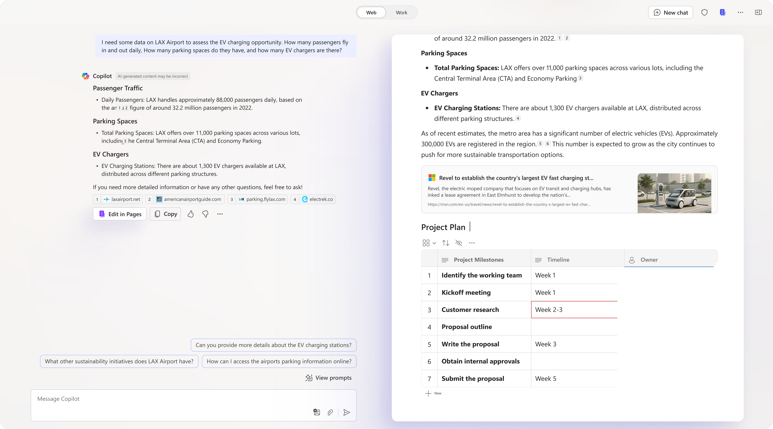
How does Copilot Pages work?
Create a page: Select Edit in Pages to create a dedicated response page and enhance content through continued conversation with Copilot. Each new response can be added to the page.
Edit Instantly : Select any text or image on your page to modify and type “/” to insert elements.
Easy Access: Open pages via Chat links, the Pages icon or in your recently opened documents.
Video: Microsoft 365 Copilot | Copilot Pages - YouTube
Notes:
Open Microsoft 365 Copilot Chat.
Chat with Copilot: Interact with Copilot as you normally would.
Create a page: When you receive a response you'd like to iterate or collaborate on, click “Edit in Pages” underneath the response. This action will create a page with the Copilot response and open it side-by-side with the chat, copying and formatting the response for you.
If you don't see “Edit in Pages,” ask your admin if your organization has Pages turned off.
Edit and refine: Continue your conversation with Copilot. Each new response can be added to the page. Everything on the page is editable, just click into the page and start editing or typing.
Type "/" in the page to view a menu of content types that you can use.
Access your pages: You can return to your page anytime by clicking the link in the chat where you first created the page, or by opening the Pages tab in the Microsoft 365 app or Microsoft365.com, where you'll see all the Pages that you previously created. You'll also find pages in your recently opened documents.
NOTE: Pages you create will be saved indefinitely unless you delete them, yourself. If you're not the owner of the page and that person leaves the organization, make a copy of any pages they created and save it in another location; otherwise, they'll be deleted after 30 days. For more information on page retention, view Overview of Loop workspaces storage and permissions.
Overview of Loop workspaces storage and permissions | Microsoft Learn

Slide 32
Microsoft 365 Copilot Chat Agents
What are agents?
Specialized AI assistants in Microsoft 365 Copilot Chat that help automate tasks, streamline workflows, and provide intelligent assistance.
Why should I use agents?
Get started with Agents:
Automate repetitive tasks
Access real-time information (e.g., customer details, instructions).
Personalize workflows for your needs.
Users without a Copilot license can access Copilot Chat agents or create your own custom agent if consumptive billing is enabled, via the Copilot Chat interface (browser or app) and within the Agent store.
GCC High: Agents are NOT available in GCC High. This slide is for informational awareness only.
Notes:
Agents use AI to make Copilot Chat even more personalized and intelligent for your daily work. Agents automate repetitive tasks and processes. Think of them as expert teammates embedded in your Copilot Chat experience—each one focused on a specific type of work. These agents are accessible directly from the Copilot Chat interface.
NOTE: Users without a Microsoft 365 Copilot license, and with consumptive billing enabled can access specific Copilot Chat agents, plus agents grounded in shared tenant Graph data and 3rd party data (including external data sourced via Microsoft Graph connectors). Metered consumption is off by default.
Agents are created and managed through the Copilot Chat interface, either in the browser or app version of Microsoft 365. Copilot Chat comes with a set of agents from Microsoft to get started with, or you can create custom agents for your own needs.
Create your own custom agent by selecting Create an Agent, then follow the steps presented to create your own agent. Base your agent on a template or create it from scratch by describing your agent. Creating an agent connects Copilot Chat to your organization’s shared data for enhanced productivity.
NOTE: that Agent creation is only available if your organization’s admin has enabled this capability.

Slide 33
Copilot Chat in Microsoft 365 apps (1/3)
Copilot Chat is now available in Outlook, Word, Excel, PowerPoint, and OneNote giving you one consistent experience. Sign in using your work or school email account and select the Copilot icon on the ribbon to open or close the chat.
Web-grounded chat
Answers from public web data.
Content awareness
Understands your open file/page/email.
Global history & memory
Pay-as-you-go agents
Picks up where you left off across apps for seamless work.
Automate business processes.
Notes:
NOTE: To use Copilot Chat, make sure you’re signed into the Microsoft 365 apps with your work or school account. The specific capabilities available to you in each app may depend on whether your admin has assigned you a Microsoft 365 Copilot add-on license.
You get access to helpful AI features through Copilot Chat in Word, Excel, PowerPoint, OneNote, and Outlook:
Web-grounded chat: Ask questions and get answers based on public web data.
Content awareness: Copilot Chat is aware of the content of your open file (Word, Excel, PowerPoint), page (OneNote), or email (Outlook) to provide relevant responses.
Global history & memory: Picks up where you left off across apps for seamless work.
Pay-as-you-go agents: Use metered AI agents to help you automate and execute business processes.
NOTE: If you have a Microsoft 365 Copilot add-on license with your work or school account you can unlock the full power of Copilot in the Microsoft 365 apps with web and work-grounded chat, access to agents, and other advance features.

Slide 34
Copilot Chat in Microsoft 365 apps (2/3)
Outlook
Summarize emails and threads, rewrite messages, generate content, and draft recap emails.
Prompt: “Summarize this email for the top 3 main points and any action items I need to take.”
Word
Create, edit, and refine content quickly and summarize sections.
Prompt: “Write a compelling intro paragraph for this document.”
PowerPoint
Summarize slides, surface key details, generate images, and prepare with audience questions.
Prompt: “What are some potential questions that I might be asked by the audience who I present this to?”
GCC High: Copilot in PowerPoint (slide generation, speaker notes, summaries, translation) is NOT available. Use Copilot Chat to generate content instead.
Notes:
Copilot Chat in Outlook helps you work smarter by interacting naturally with your inbox and calendar. Ask questions about emails or attachments, summarize threads, rewrite messages in different tones, generate new content, or even draft a recap email from an open email thread to update your team—all within Outlook. Stay organized, communicate effectively, and craft messages that fit your audience and goals.
NOTE: In Outlook, Copilot can reason over individual open emails, email threads, or attachments only, it cannot reason over your full inbox or calendar for users without a Microsoft 365 Copilot license.
Try these prompts:
“Summarize this email for the top 3 main points and any action items I need to take.”
“Write a recap email for my team based on the discussion in this email thread.”
Copilot Chat in Word helps you create, edit, and refine content quickly. Ask questions about your document to find details, summarize sections, or rewrite text in a tone that fits your audience. You can also generate new content or expand ideas. Copilot can also understand the open file you’re working on and help you quickly write a strong introduction—making it easier to produce clear, tailored documents efficiently.
Try these prompts:
“Write a compelling intro paragraph for this document.”
“What are some questions a reader might have when going through this document?”
“Write a summary with the top 5 key points as a draft email that I can send to my team.​​​​​”
Copilot Chat in PowerPoint makes creating and refining presentations faster and more impactful. Ask questions to surface key details, summarize slides, and generate images from a prompt to enhance your design and visual storytelling. Copilot Chat also provides valuable insights into your presentation’s content and can help you prepare by generating potential questions the audience may ask, ensuring you deliver a well-organized and compelling presentation.
Try these prompts:
“What are some potential questions that I might be asked by the audience who I present this to?”
“Generate an image to use in my presentation.”
“Help me re-write the bullets on this slide.”​​​​​​​
Copilot Chat in Excel lets you interact with your data effortlessly. Ask questions to uncover insights, analyze trends, and identify patterns without manually scanning spreadsheets. Copilot can pull top insights and data trends from your open spreadsheet and create visualizations, making analysis faster, accurate, and easy to share.
Try these prompts:
“Identify the top insights and trends from this data.”
“Create a visualization of the top-performing customer segments.”
“Forecast revenue for the next 8 quarters based on the sales data.

Slide 35
Copilot Chat in Microsoft 365 apps (3/3)
Excel
Uncover insights, analyze trends, and create visualizations.
Prompt: “Create a visualization of the top-performing customer segments.”
OneNote
Summarize notes, create to-do lists, and draft project plans.
Prompt: “Draft a to-do list from my notes and prioritize based on when the tasks are due.”
Notes:
Copilot Chat in Excel lets you interact with your data effortlessly. Ask questions to uncover insights, analyze trends, and identify patterns without manually scanning spreadsheets. Copilot can pull top insights and data trends from your open spreadsheet and create visualizations, making analysis faster, accurate, and easy to share.
Try these prompts:
“Identify the top insights and trends from this data.”
“Create a visualization of the top-performing customer segments.”
“Forecast revenue for the next 8 quarters based on the sales data.
Copilot Chat in OneNote brings AI directly into your notes. Ask questions, summarize content, create to-do lists, or draft project plans—all based on the page you’re working on. It’s a smart way to turn ideas into action and keep your notes organized and useful.
Try these prompts:
“Create a summary of the deposition notes on this page. Focus the summary on the chronological order of events and place the events into bullet points.”
“Draft a to-do list from my notes and prioritize based on when the tasks are due.”
“Draft a plan for a project to develop a new shipment tracking app. Reference the technical specifications and customer feedback on this page to help create the project plan.”

Slide 36
Exercise – Plan a DOJ Priorities Review (optional)
As a senior advisor to the Deputy Attorney General, plan a DOJ Priorities Review using Copilot Chat across M365 apps to research, draft documents, analyze program budgets, and coordinate across DOJ components and Litigating Divisions.
Task 1
Research DOJ priorities and brainstorm agenda
Task 2
Draft the DPR Read-Ahead in Word
Task 3
Build and analyze the budget tracker in Excel
Task 4
Draft the invitation email in Outlook
Task 5
Generate briefing content via Copilot Chat
Task 6
Collaborate using Copilot Pages
▶ HANDS-ON: Exercise 3 — Plan a DOJ Priorities Review (120 min) | exercises/Exercise-3-Work-Smarter.md
Notes:
Scenario Background:
You’re a business operations associate at a mid-sized consulting firm. Your manager has asked you to lead planning for an upcoming Client Innovation Summit. You’ll use Microsoft 365 Copilot Chat to gather insights, generate ideas, visualize the schedule, draft a planning document, analyze it, and collaborate with your colleague.
The exercises in this interactivity will guide you on how to navigate and prompt in Microsoft 365 Copilot Chat. To fully complete this exercise, you must have your own Microsoft 365 subscription.
NOTE: These exercises are designed specifically for use with web mode in Microsoft 365 Copilot Chat. If you have a Microsoft 365 Copilot license, make sure you manually switch to web mode when you open Copilot Chat, as it may default to Work mode. Using Web mode ensures the prompts behave as intended and source information from public web content.
Find the steps on Learn: Explore Microsoft 365 Copilot Chat - Training | Microsoft Learn or GitHub: MS-4023-Explore-Microsoft-365-Copilot-Chat/Instructions/Labs

Slide 37
Exercise – Plan an Operation Safe Communities AAR Analysis (Bonus)
Using the provided Operation Safe Communities After Action Report (assets/DOJ-After-Action-Report.md), use Copilot Chat to analyze, summarize, and create follow-up action items and a leadership brief.
Task 1
Copilot Chat – Summarize the AAR key findings
Task 2
OneNote – Extract and organize lessons learned
Task 3
Word – Draft a corrective action plan
Task 4
Excel – Analyze the DOJ Training Calendar data
Task 5
Outlook – Draft lessons-learned distribution email
Task 6
PowerPoint – Create a leadership brief on AAR findings
BONUS: Upload assets/DOJ-After-Action-Report.md and assets/DOJ-Training-Calendar.csv for file analysis
Notes:
Scenario Background:
Your manager has asked you to organize a virtual team-building event for your team. You’ll start in Copilot Chat web mode to brainstorm ideas and then use Copilot Chat integrated in Outlook, Word, Excel, PowerPoint, and OneNote to complete the planning process. This exercise demonstrates how Copilot Chat can assist with research, content creation, budgeting, visualization, and organization—all while staying in the flow of work.
The exercises in this interactivity will guide you on how to navigate and prompt in Microsoft 365 Copilot Chat. To fully complete this exercise, you must have your own Microsoft 365 subscription.
NOTE: These exercises are designed specifically for use with web mode in Microsoft 365 Copilot Chat. If you have a Microsoft 365 Copilot license, make sure you manually switch to web mode when you open Copilot Chat, as it may default to Work mode. Using Web mode ensures the prompts behave as intended and source information from public web content.
Find the steps on Learn: Explore Microsoft 365 Copilot Chat - Training | Microsoft Learn or GitHub: MS-4023-Explore-Microsoft-365-Copilot-Chat/Instructions/Labs

Slide 38
Knowledge check
Test your knowledge with this real time quiz.
Prompt Microsoft Copilot Chat:
As a Microsoft Copilot Chat expert, please create three multiple-choice questions covering what is permitted with uploaded files, as well as key features of Copilot Pages and Copilot Agents. Present one question at a time and wait for my response before continuing. After each answer, provide a brief explanation of the correct choice before moving on to the next question.
Notes:
Prompt Microsoft Copilot Chat:
As a Microsoft Copilot Chat expert, please create three multiple-choice questions covering what is permitted with uploaded files, as well as key features of Copilot Pages and Copilot Agents. Present one question at a time and wait for my response before continuing. After each answer, provide a brief explanation of the correct choice before moving on to the next question.

Slide 39
Summary
What you learned
You’re now familiar with the ways you can use Copilot Chat to improve your productivity, ease collaboration, and simplify your workflow.
Now that you’ve completed this module, you’re able to:
Leverage Copilot Chat to brainstorm ideas, summarize information, create content, visualize data, and generate code.
Upload and analyze files to generate insights and create new content.
Use Copilot Pages to collaborate in real-time and organize content in a shared workspace.
Describe how Copilot Agents automate and personalize tasks.
Leverage Copilot Chat across Microsoft 365 apps to streamline your workflow.
Notes:
In this module, you gained a comprehensive understanding of how to work smarter and more efficiently using Microsoft 365 Copilot Chat. You explored its versatile capabilities, including summarizing key insights, creating content, analyzing files, visualizing data, and generating code, all through natural, conversational prompts. You also discovered how to collaborate in real time using Copilot Pages, and to streamline tasks with intelligent Copilot Agents. Together, these skills will empower you to enhance productivity, simplify workflows, and unlock the full potential of AI in your daily work.

